Slide 1
YouTube Audience Reaction Analysis. US Videos
Group 2
NAMES | REG. NO
TURYA JOHN STEVEN | 2023-B071-21285
WALWASA NATHAN ABEL | 2023-B071-21203
BIRUNGI BRIDGET | 2023-B071-22674
SSEMANDA JONATHAN | 2023-B071-22335
NALULE CATHERINE | 2023-B071-22337
NSUBUGA NICHOLAS PAUL | 2023-B071-22173

Slide 2
OVERVIEW
Title: YouTube audience reaction. (What drives engagement?)
Overall sentiment is positive. The vast majority of content (64%) generates a positive reaction, indicating a generally favorable audience mood.
Controversy drives clicks. Despite the positive skew, videos with negative sentiment attract 21% more views on average, highlighting the power of controversial or emotionally charged content.
Category matters. Content in travel and events and pets and animals is received most positively, while news and politics is the most polarizing category.
Top Keywords. The most frequent topics revolve around "video," "music," "new," and "2018," showing a focus on timely and entertaining content.

Slide 3
BUSINESS UNDERSTANDING
Why Analyze Audience Reaction?
Objective.
To analyze audience sentiment and emotional tone from YouTube video data to inform and improve content strategy.
Key Business Questions:
  What is the overall sentiment (positive, negative, neutral) of the audience?
  Which video categories generate the most positive or negative reactions?
  What topics or keywords are associated with different sentiments?
  Do videos with stronger emotional reactions receive more engagement?

Slide 4
METHODOLOGY
How We Analyzed Sentiment without comments
Data Source
  USvideos.csv dataset containing metadata for 40,949 trending videos.
Methodology.
Proxy for comments. Since user comments were not available, we analyzed the combined text from video titles and descriptions. This serves as a proxy for the content's intended message and emotional framing.
Sentiment analysis. We used TextBlob, a natural language processing library, to classify the polarity of the text as positive, negative, or neutral.
Keyword Extraction. We identified key topics using TF-IDF and Word Count analysis to see what themes were most prominent.

Slide 5
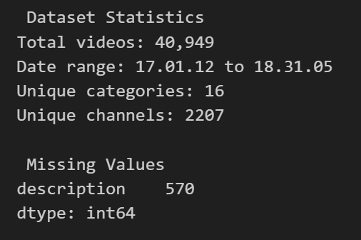
DATASET STATISTICS

Slide 6
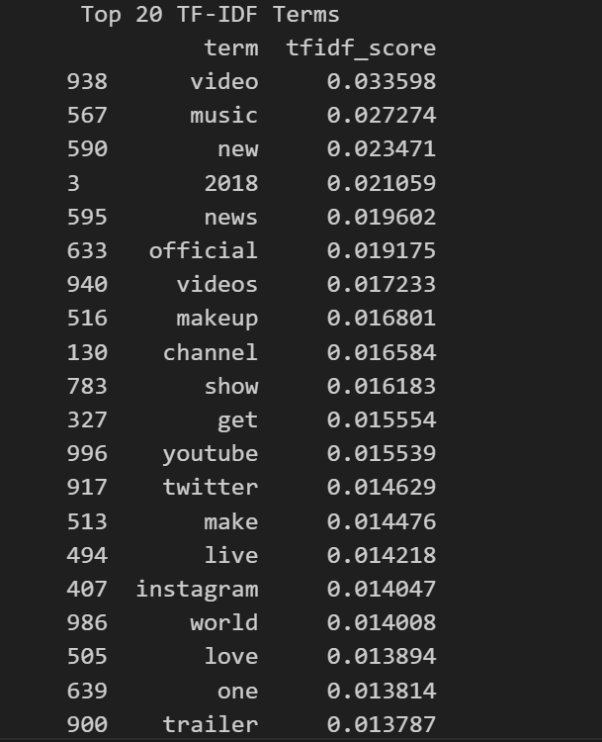
TOP 20 TF-IDF TERMS

Slide 7
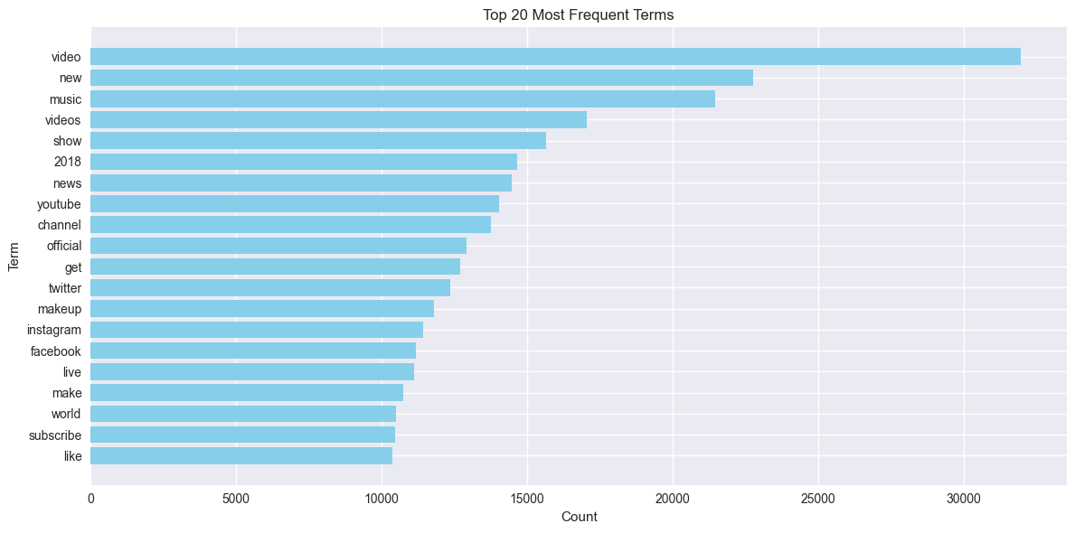
TOP 20 MOST FREQUENT WORDS

Slide 8
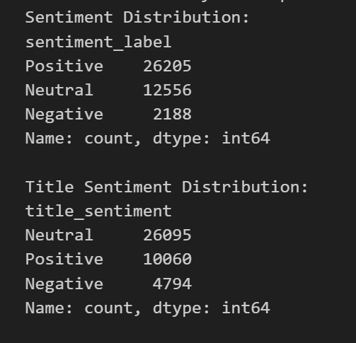
SENTIMENT ANALYSIS

Slide 9
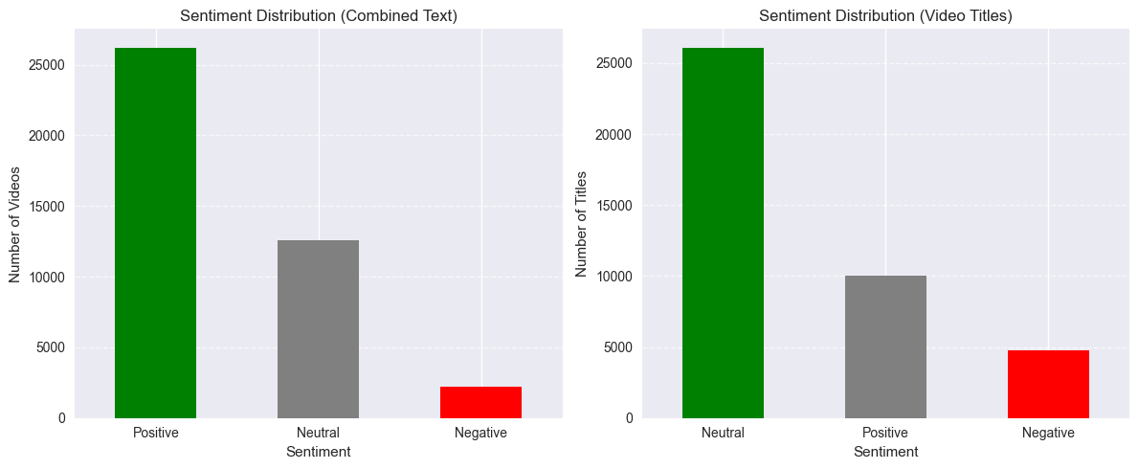
SENTIMENT DISTRIBUTION

Slide 10
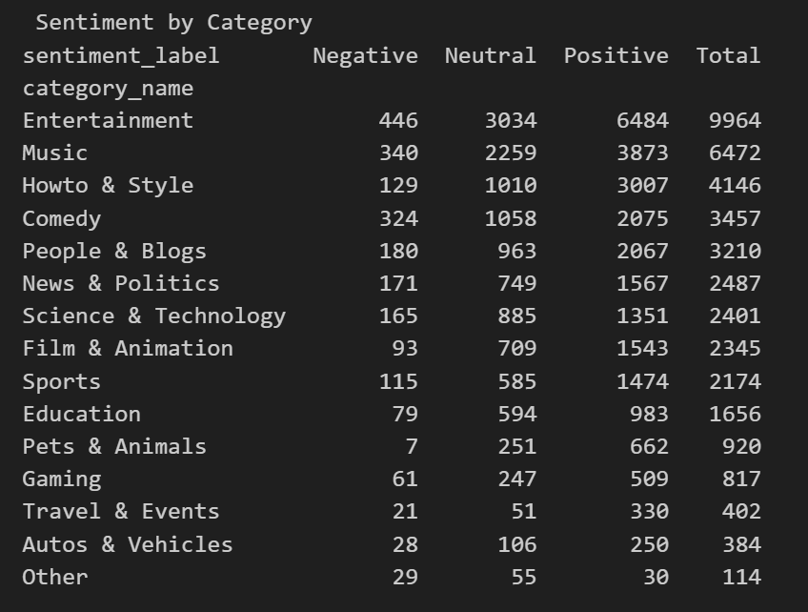
SENTIMENT STATISTICS

Slide 11
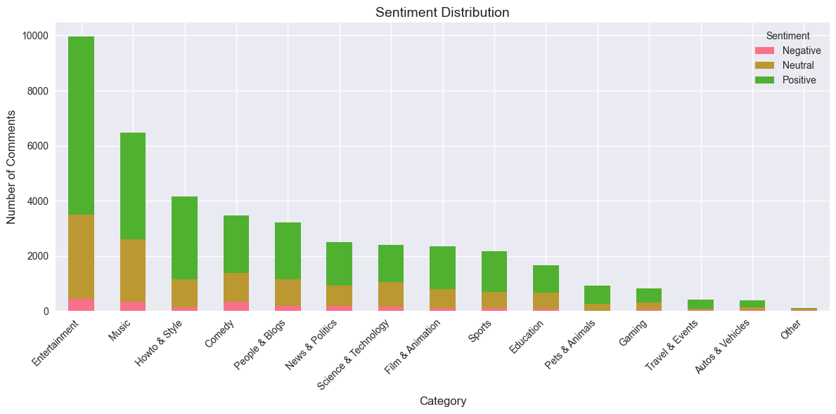
SENTIMENT DISTRUBUTION

Slide 12
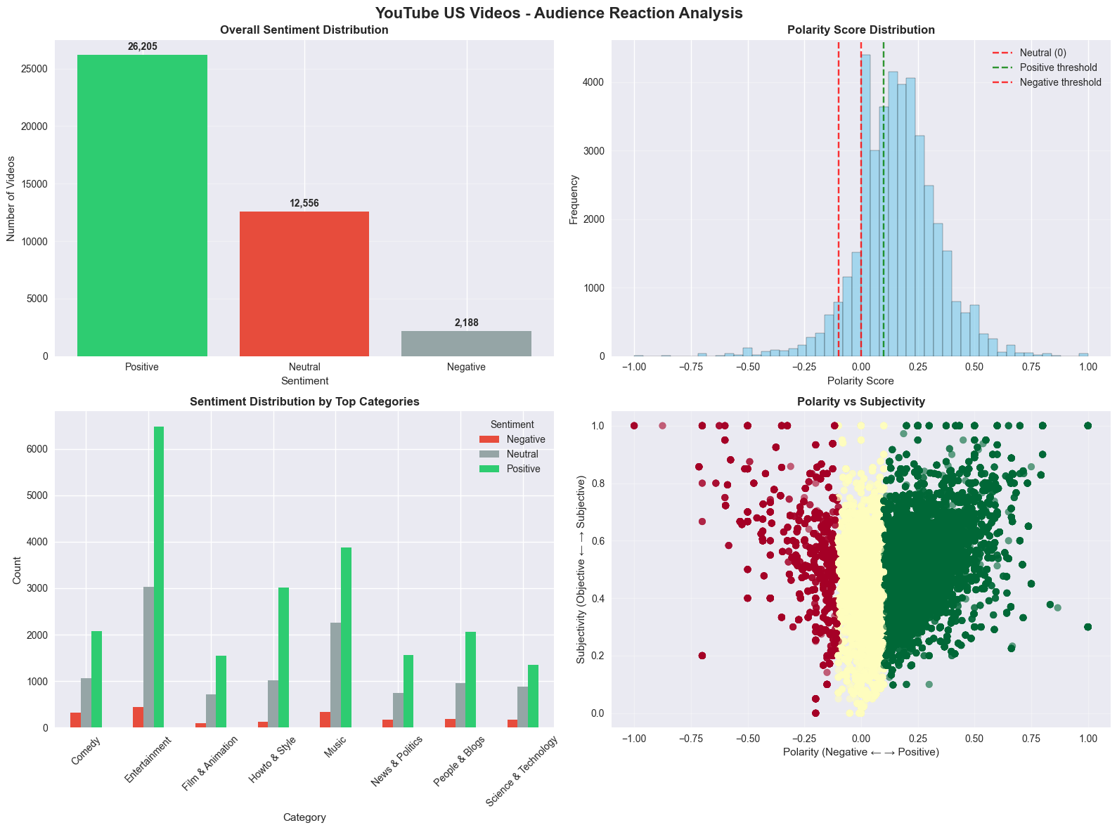
SENTIMENT ANALYSIS VISUALIZATION

Slide 13
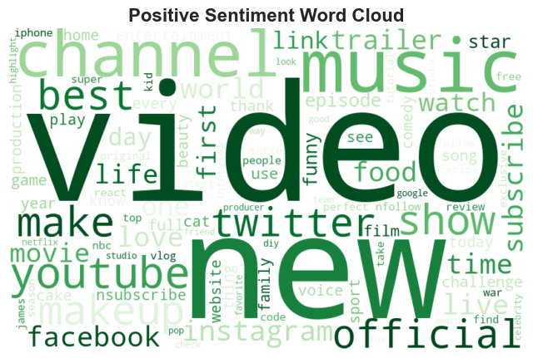
POSITIVE SENTIMENT WORD CLOUD

Slide 14
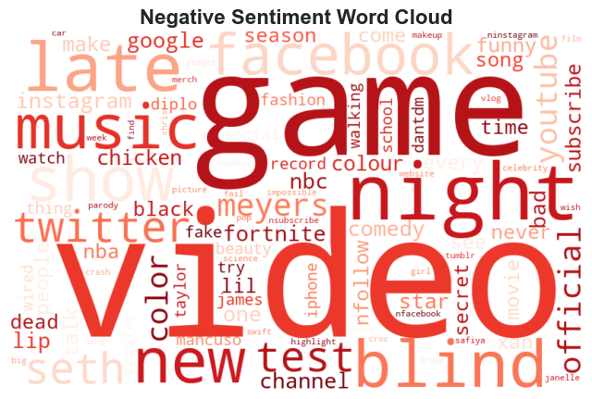
NEGATIVE SENTIMENT WORD CLOUD

Slide 15
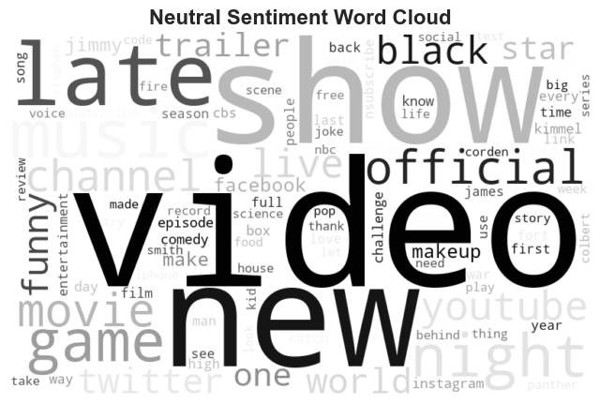
NEUTRAL SENTIMENT WORD CLOUD

Slide 16
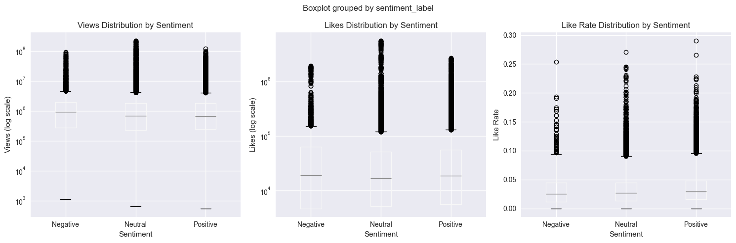
ENGAGEMENT ANALYSIS

Slide 17
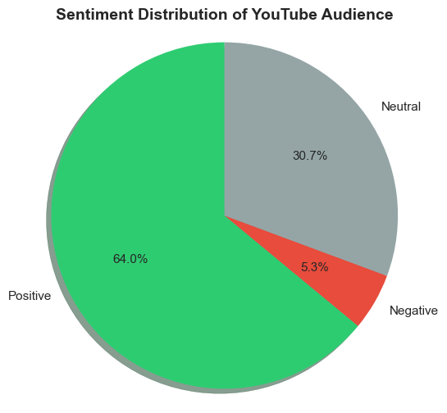
SUMMARY OF SENTIMENT DISTRIBUTION

Slide 18
Interpretation - Emotional Tone & Response Patterns
Emotional tone.
  Overall mood. Positive (Average polarity: 0.159)
  Dominant emotion. Satisfaction. The audience generally shows approval and contentment rather than extreme excitement or anger.
  Engagement style: Moderately expressive and balanced. The average subjectivity score (0.48) indicates that the content is more objective than opinion-based, and the audience responds in a measured way.
Key audience response patterns.
  Positivity is the norm. Audiences are far more likely to react positively than negatively.
  Controversy attracts attention: Negative content, though less common is a significant engagement magnet.
  Lifestyle content wins hearts: Travel, animals, and sports are "safe" and highly positive categories.
  Information can be divisive: News and political content while engaging creates the most polarized reactions.

